Slide 1

Discrete Probability Models
MTH 564 – Mathematical Modeling

Slide 2

Overview
Many real-life problems have a degree of uncertainty.
Human (and animal) behavior can appear to have a random element.
Even some physical systems, such as quantum mechanical systems, have random elements
To model randomness and uncertainty we use discrete and/or continuous models

Slide 3
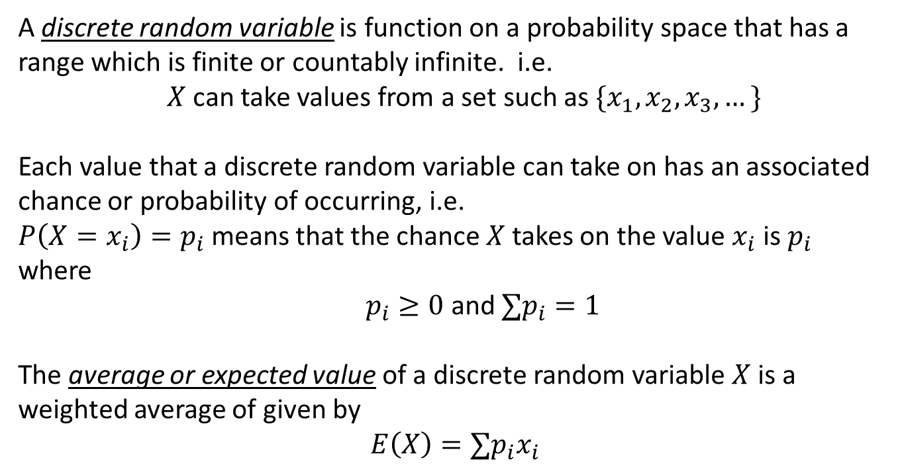
Discrete Probability Models
A discrete random variable is function on a probability space that has a range which is finite or countably infinite. i.e.
$X$can take values from a set such as $\{x_{1},x_{2}, x_{3},…\}$
Each value that a discrete random variable can take on has an associated chance or probability of occurring, i.e.
$P\left(X=x_{i}\right)=p_{i}$ means that the chance $X$ takes on the value $x_{i}$ is $p_{i}$ where $p_{i}≥0$ and $∑p_{i}=1$
The average or expected value of a discrete random variable $X$ is a weighted average of given by
$$E\left(X\right)=∑p_{i}x_{i}$$

Slide 4
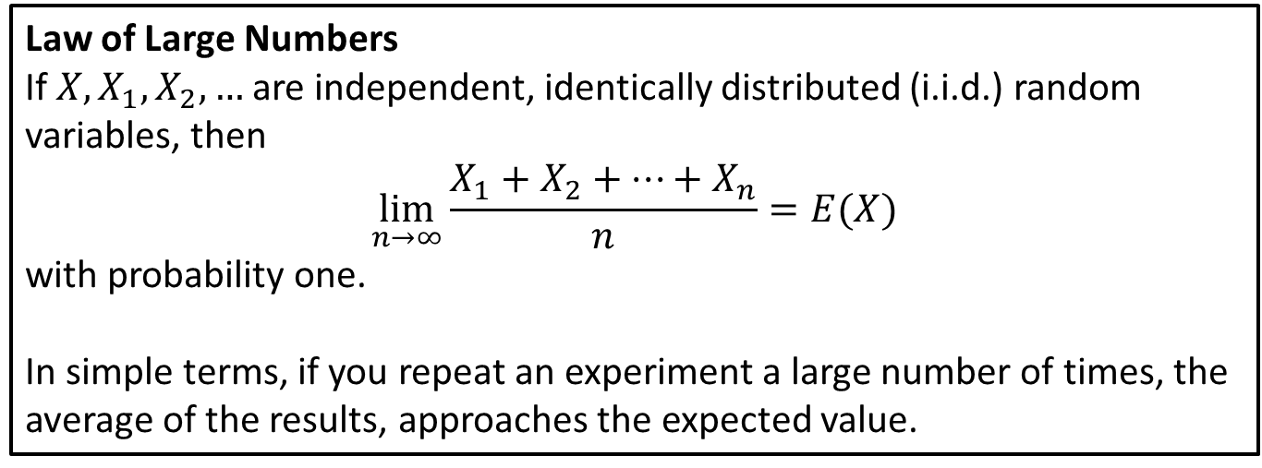
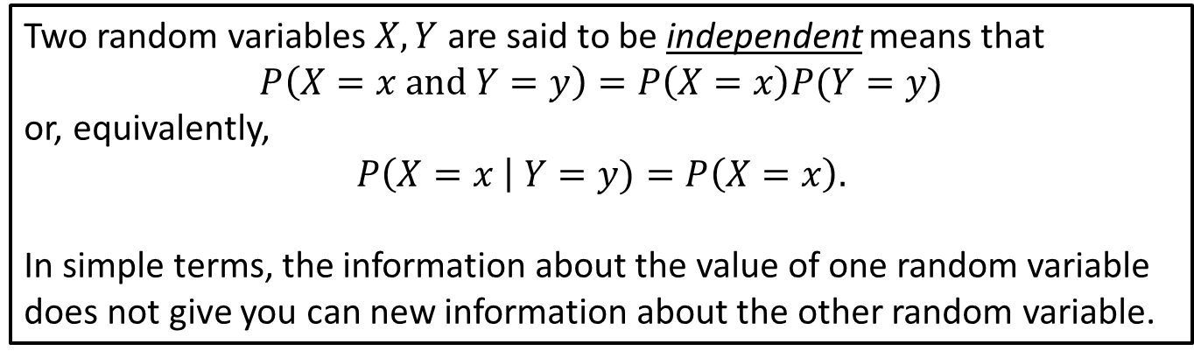
Discrete Probability Models
Two random variables $X, Y$ are said to be independent means that
$$P\left(X=x and Y=y\right)=P\left(X=x\right)P(Y=y)$$
or, equivalently,
$$P\left(X=x \right| Y=y)=P\left(X=x\right).$$
In simple terms, the information about the value of one random variable does not give you can new information about the other random variable.
Law of Large Numbers
If $X, X_{1},X_{2}, …$ are independent, identically distributed (i.i.d.) random variables, then
$$\lim_{n→∞}\frac{X_{1}+X_{2}+…+X_{n}}{n}=E(X)$$
with probability one.
In simple terms, if you repeat an experiment a large number of times, the average of the results, approaches the expected value.

Slide 5
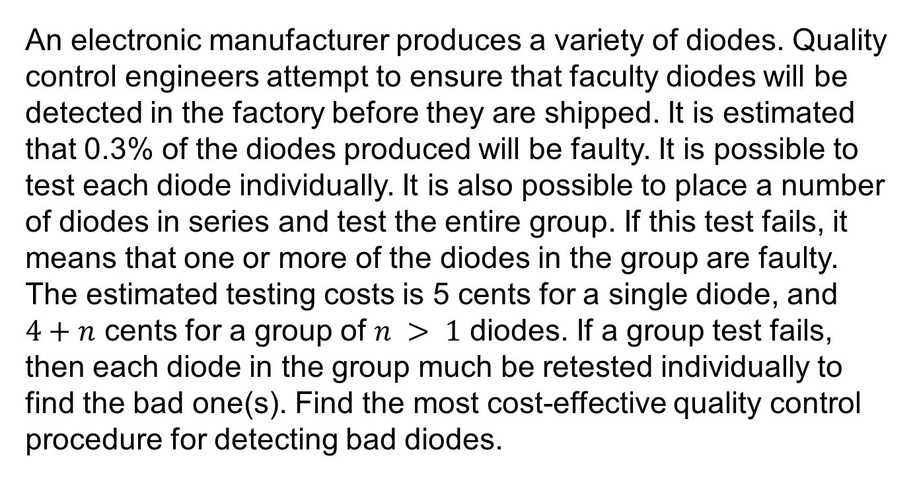
Problem
An electronic manufacturer produces a variety of diodes. Quality control engineers attempt to ensure that faculty diodes will be detected in the factory before they are shipped. It is estimated that 0.3% of the diodes produced will be faulty. It is possible to test each diode individually. It is also possible to place a number of diodes in series and test the entire group. If this test fails, it means that one or more of the diodes in the group are faulty. The estimated testing costs is 5 cents for a single diode, and $4+n$ cents for a group of $n > 1$ diodes. If a group test fails, then each diode in the group much be retested individually to find the bad one(s). Find the most cost-effective quality control procedure for detecting bad diodes.

Slide 6

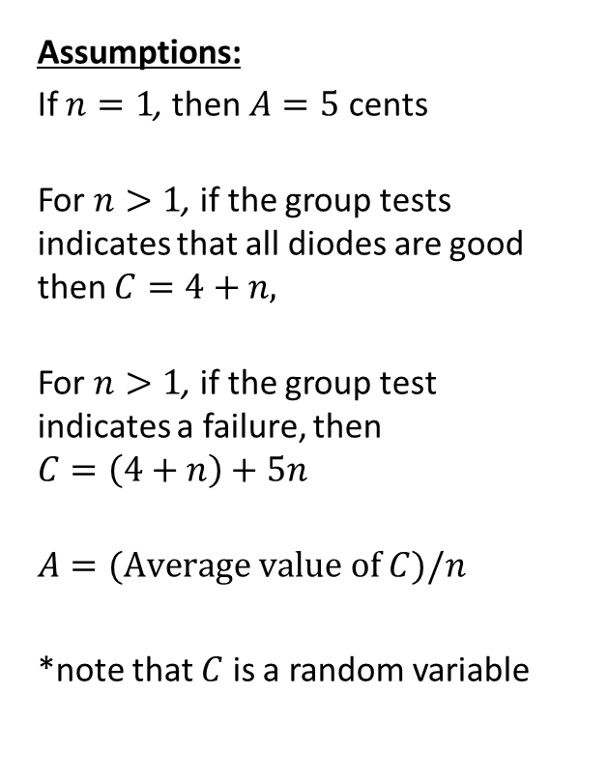
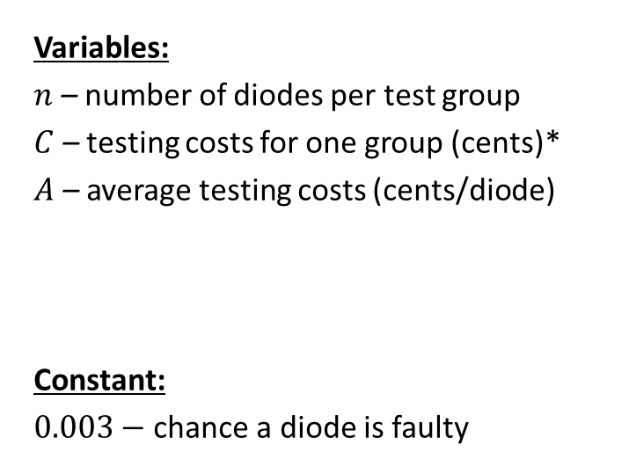
Step 1: Frame the problem
Variables:
$n$ – number of diodes per test group
$C$ – testing costs for one group (cents)*
$A$ – average testing costs (cents/diode)
Constant:
$0.003−$ chance a diode is faulty
Assumptions:
If $n=1$, then $A=5$ cents
For $n>1$, if the group tests indicates that all diodes are good then $C=4+n,$
For $n>1$, if the group test indicates a failure, then $$C=\left(4+n\right)+5n$$
$$A=(Average value of C)/n$$
*note that $C$ is a random variable
Objective
Find the value of $n$ that minimizes $A$.

Slide 7
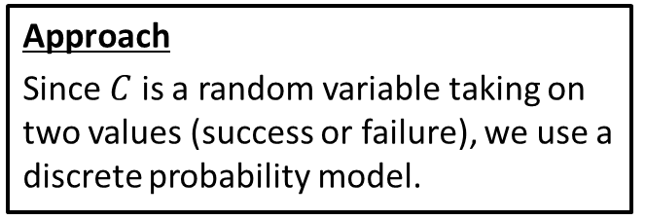

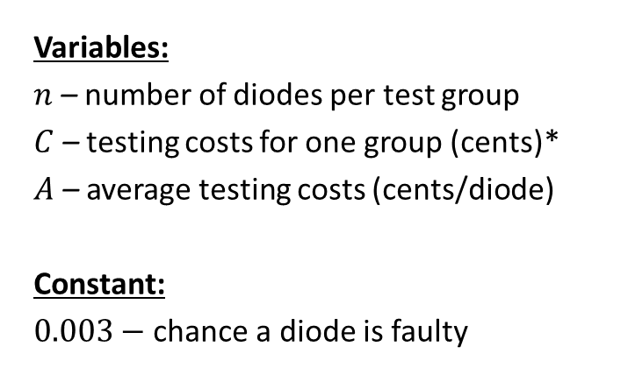
Step 2: Select the modeling approach
Variables:
$n$ – number of diodes per test group
$C$ – testing costs for one group (cents)*
$A$ – average testing costs (cents/diode)
Constant:
$0.003−$ chance a diode is faulty
Assumptions:
If $n=1$, then $A=5$ cents
For $n>1$, if the group tests indicates that all diodes are good then $C=4+n,$
For $n>1$, if the group test indicates a failure, then $$C=\left(4+n\right)+5n$$
$$A=(Average value of C)/n$$
*note that $C$ is a random variable
Objective
Find the value of $n$ that minimizes $A$.
Approach
Since $C$ is a random variable taking on two values (success or failure), we use a discrete probability model.

Slide 8
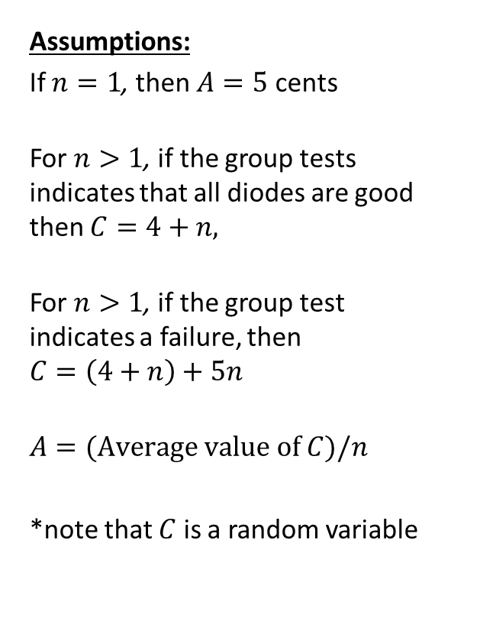
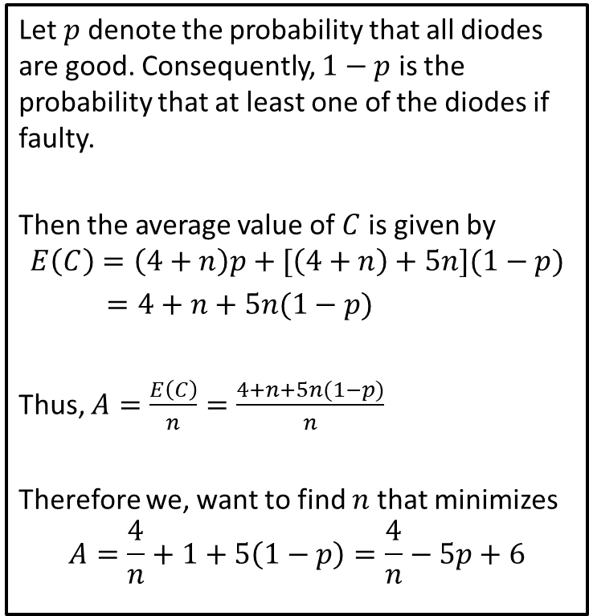
Step 3: Formulate the model
Let $p$ denote the probability that all diodes are good. Consequently, $1−p$ is the probability that at least one of the diodes if faulty.
Then the average value of $C$ is given by
$$E\left(C\right)=\left(4+n\right)p+[\left(4+n\right)+5n](1−p)$$
$=4+n+5n(1−p)$
Thus, $A=\frac{E\left(C\right)}{n}=\frac{4+n+5n(1−p)}{n}$
Therefore we, want to find $n$ that minimizes
$$A=\frac{4}{n}+1+5\left(1−p\right)=\frac{4}{n}−5p+6$$
Assumptions:
If $n=1$, then $A=5$ cents
For $n>1$, if the group tests indicates that all diodes are good then $C=4+n,$
For $n>1$, if the group test indicates a failure, then $$C=\left(4+n\right)+5n$$
$$A=(Average value of C)/n$$
*note that $C$ is a random variable

Slide 9
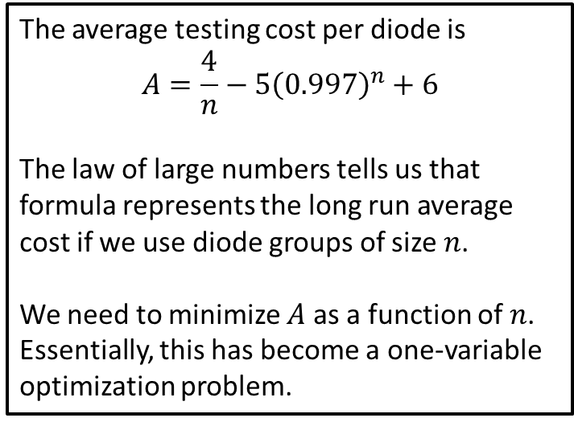

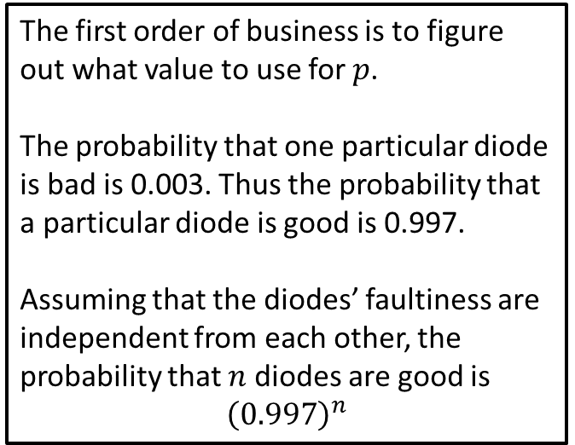
Step 4: Solve the Problem
We left off step 3 with the following
$$A=\frac{4}{n}−5p+6$$
where $p$ is the probability that all diodes are good (NOT faulty).
The first order of business is to figure out what value to use for $p$.
The probability that one particular diode is bad is 0.003. Thus the probability that a particular diode is good is 0.997.
Assuming that the diodes’ faultiness are independent from each other, the probability that $n$ diodes are good is
$${\left(0.997\right)}^{n}$$
The average testing cost per diode is
$$A=\frac{4}{n}−5{\left(0.997\right)}^{n}+6$$
The law of large numbers tells us that formula represents the long run average cost if we use diode groups of size $n$.
We need to minimize $A$ as a function of $n$. Essentially, this has become a one-variable optimization problem.
Notes:
See python file section1-1pig.py

Slide 10
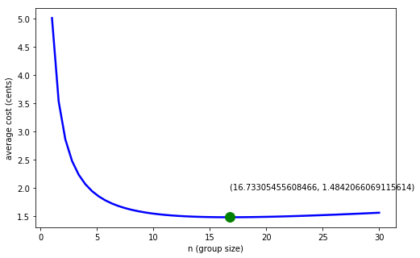


Step 4: Solve the Problem
We seek to minimize
$$A=\frac{4}{n}−5{\left(0.997\right)}^{n}+6$$
With respect to $n$.
We use the minimize_scalar function in scipy.optimize tells us that the minimum occurs at
$$n≈16.7$$
with a minimum average cost of
$$A≈1.48$$
The graph confirms this result
Notes:
See python file section1-1pig.py

Slide 11
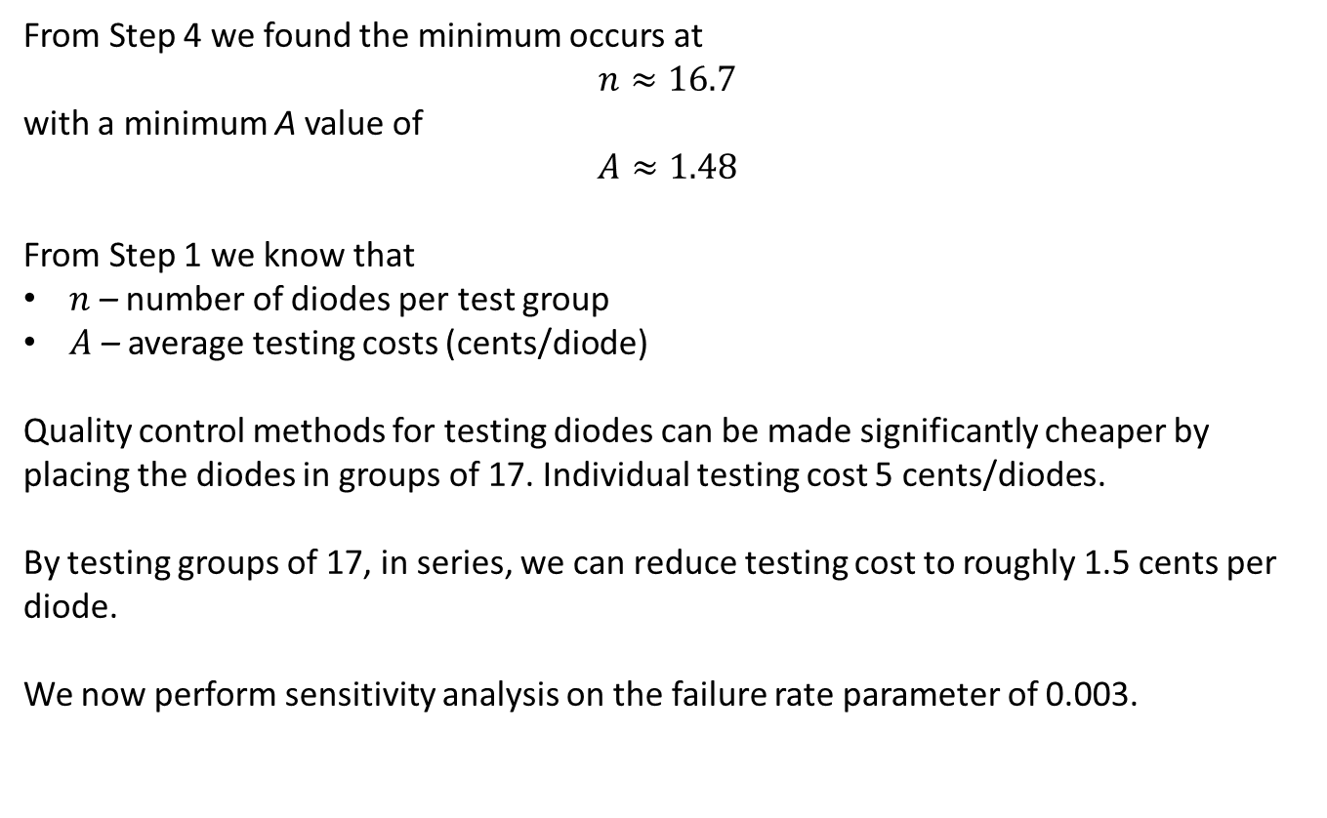
Step 5: Answer the question
From Step 4 we found the minimum occurs at
$$n≈16.7$$
with a minimum A value of
$$A≈1.48$$
From Step 1 we know that
$n$ – number of diodes per test group
$A$ – average testing costs (cents/diode)
Quality control methods for testing diodes can be made significantly cheaper by placing the diodes in groups of 17. Individual testing cost 5 cents/diodes.
By testing groups of 17, in series, we can reduce testing cost to roughly 1.5 cents per diode.
We now perform sensitivity analysis on the failure rate parameter of 0.003.

Slide 12
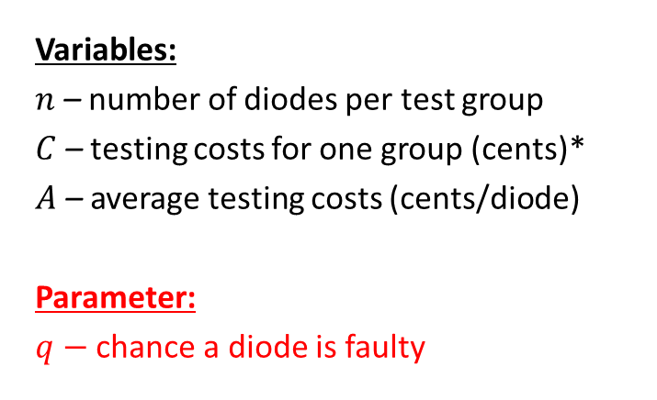
Sensitivity Analysis
Variables:
$n$ – number of diodes per test group
$C$ – testing costs for one group (cents)*
$A$ – average testing costs (cents/diode)
Parameter:
$q−$ chance a diode is faulty
Assumptions:
If $n=1$, then $A=5$ cents
For $n>1$, if the group tests indicates that all diodes are good then $C=4+n,$
For $n>1$, if the group test indicates a failure, then $$C=\left(4+n\right)+5n$$
$$A=(Average value of C)/n$$
*note that $C$ is a random variable
Objective
Find the value of $n$ that minimizes $A$.
Approach
Since $C$ is a random variable taking on two values (success or failure), we use a discrete probability model.

Slide 13
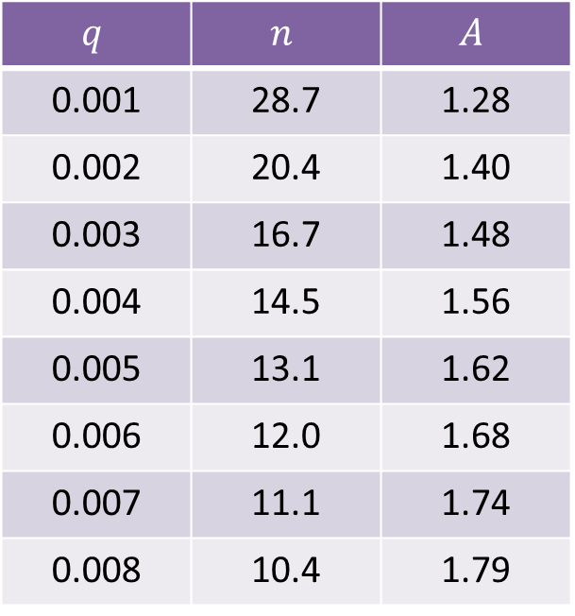

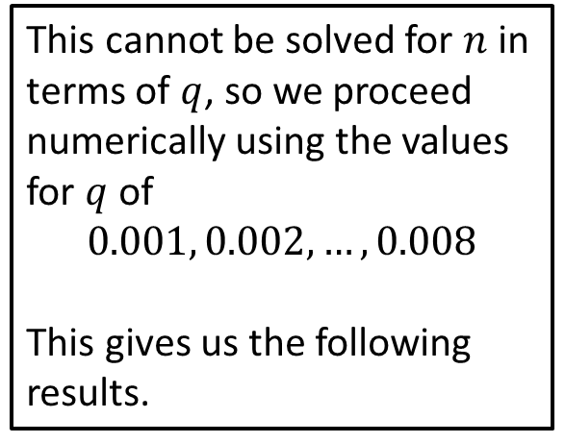
Sensitivity Analysis: Failure Rate
We seek to minimize
$$A=\frac{4}{n}−5{\left(1−q\right)}^{n}+6$$
with respect to $n$.
This cannot be solved for $n$ in terms of $q$, so we proceed numerically using the values for $q$ of
$$0.001, 0.002, …, 0.008$$
This gives us the following results.
$$q$$ | $$n$$ | $$A$$
0.001 | 28.7 | 1.28
0.002 | 20.4 | 1.40
0.003 | 16.7 | 1.48
0.004 | 14.5 | 1.56
0.005 | 13.1 | 1.62
0.006 | 12.0 | 1.68
0.007 | 11.1 | 1.74
0.008 | 10.4 | 1.79
Notes:
See python file section1-1pig.py

Slide 14
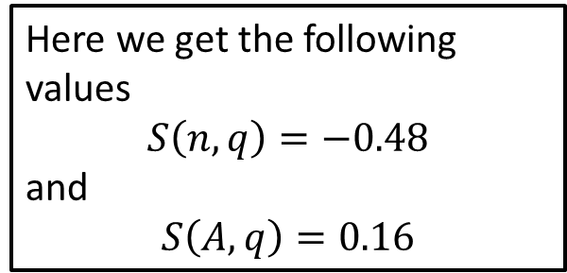
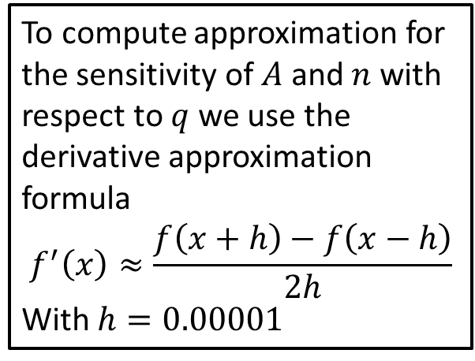
Sensitivity Analysis: Failure Rate
We seek to minimize
$$A=\frac{4}{n}−5{\left(1−q\right)}^{n}+6$$
with respect to $n$.
To compute approximation for the sensitivity of $A$ and $n$ with respect to $q$ we use the derivative approximation formula
$$f^{′}\left(x\right)≈\frac{f\left(x+h\right)−f\left(x−h\right)}{2h}$$
With $h=0.00001$
Here we get the following values
$$S\left(n,q\right)=−0.48$$
and
$$S\left(A,q\right)=0.16$$
Notes:
See python file section1-1pig.py

Slide 15
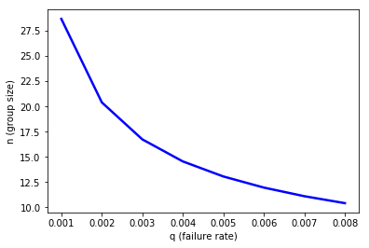
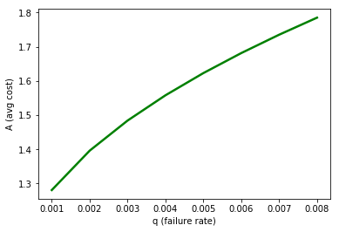
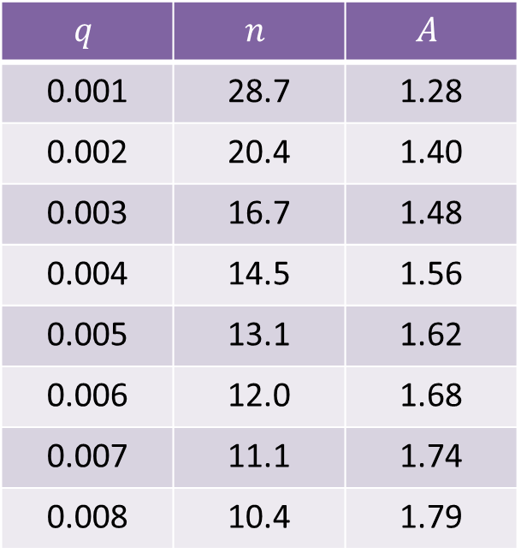
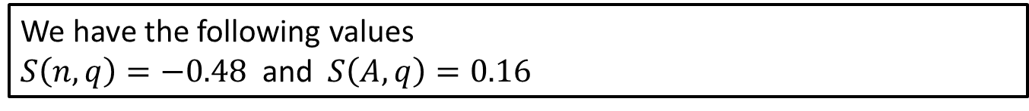
Sensitivity Analysis: Failure Rate
We have the following values
$S\left(n,q\right)=−0.48$ and $S\left(A,q\right)=0.16$
$$q$$ | $$n$$ | $$A$$
0.001 | 28.7 | 1.28
0.002 | 20.4 | 1.40
0.003 | 16.7 | 1.48
0.004 | 14.5 | 1.56
0.005 | 13.1 | 1.62
0.006 | 12.0 | 1.68
0.007 | 11.1 | 1.74
0.008 | 10.4 | 1.79
Notes:
See python file section1-1pig.py

Slide 16
Conclusion
Based on our analysis a 10% increase in the failure rate will result in the group size decreasing by about 5% and the average cost increasing by roughly 1.6%. Thus the average cost is not very sensitive to the failure rate.
A discussion of robustness would have to include the assumption of independence. It could be the case that bad diodes are made in “bunches” and thus there would be a dependence among the random variables. Modeling (and generally dealing with) dependent random variables can be very difficult. We with explore this some when we study Stochastic Processes in future lessons.

